Slide 1

Innovative EC Systems: From E-Government to
E-Learning, Collaborative Commerce, and C2C Commerce

Slide 2
Learning Objectives
Describe various e-government initiatives.
Describe e-government activities and implementation issues including e-government 2.0 and m-government.
Describe e-learning, virtual universities, and e-training.
Describe e-books and their readers.
Copyright © 2012 Pearson Education, Inc. Publishing as Prentice Hall
5-<number>

Slide 3
Learning Objectives
Describe knowledge management and dissemination as an e-business.
Describe and discuss online advisory systems.
Describe collaborative e-commerce.
Describe collaboration 2.0.
Describe C2C activities in e-commerce.
Copyright © 2012 Pearson Education, Inc. Publishing as Prentice Hall
5-<number>

Slide 4
E-Government: An Overview
e-government
E-commerce model in which a government entity buys or provides goods, services, or information to businesses or individual citizens
government-to-citizens (G2C)
E-government category that includes all the interactions between a government and its citizens
  Electronic Voting
  Electronic Benefits Transfer
Copyright © 2012 Pearson Education, Inc. Publishing as Prentice Hall
5-<number>

Slide 5
E-Government: An Overview
government-to-business (G2B)
E-government category that includes interactions between governments and businesses (government selling to businesses and providing them with services and businesses selling products and services to the government)
  Government E-Procurement
  Group Purchasing
Copyright © 2012 Pearson Education, Inc. Publishing as Prentice Hall
5-<number>

Slide 6
E-Government: An Overview
government-to-government (G2G)
E-government category that includes activities within government units and those between governments
government-to-employees (G2E)
E-government category that includes activities and services between government units and their employees
  Internal Efficiency and Effectiveness (IEE)
Copyright © 2012 Pearson Education, Inc. Publishing as Prentice Hall
5-<number>

Slide 7
E-Government: An Overview
IMPLEMENTING E-GOVERNMENT
THE TRANSFORMATION TO E-GOVERNMENT
Government 2.0
How government makes use of Web 2.0 technologies to interact with citizens and provide government services
  The Promise of Government 2.0
Copyright © 2012 Pearson Education, Inc. Publishing as Prentice Hall
5-<number>

Slide 8
E-Government: An Overview
mobile government (m-government)
The wireless implementation of e-government mostly to citizens but also to businesses
HW:
  The Benefits of M-Government
  Some Implementation Issues
  Applications
Copyright © 2012 Pearson Education, Inc. Publishing as Prentice Hall
5-<number>

Slide 9
E-Learning, E-Training, and E-Books
e-learning
The online delivery of information for purposes of education, training, or knowledge management
BENEFITS AND DRAWBACKS OF E-LEARNING
Copyright © 2012 Pearson Education, Inc. Publishing as Prentice Hall
5-<number>

Slide 10
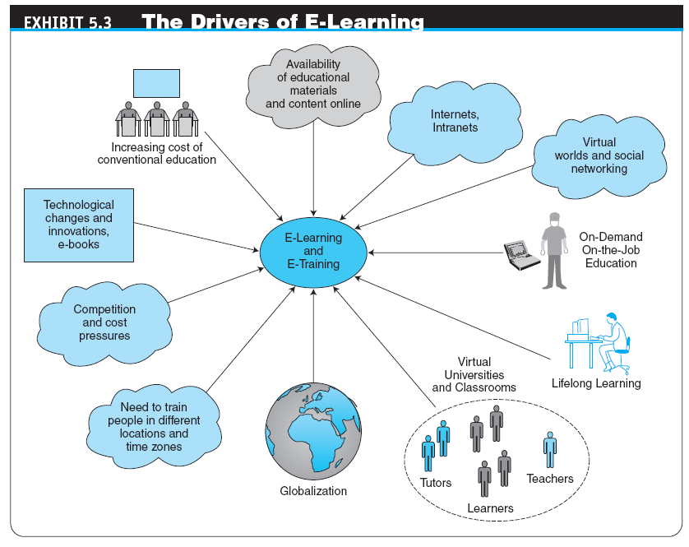
Copyright © 2012 Pearson Education, Inc. Publishing as Prentice Hall
5-<number>

Slide 11
E-Learning, E-Training, and E-Books
distance learning
Formal education that takes place off campus, usually, but not always, through online resources
  virtual university
  An online university from which students take classes from home or other offsite locations, usually via the Internet
  Innovations in E-Learning
Copyright © 2012 Pearson Education, Inc. Publishing as Prentice Hall
5-<number>

Slide 12
E-Learning, E-Training, and E-Books
ONLINE CORPORATE TRAINING
  Examples of Corporate Training
social learning
Learning, training, and knowledge sharing in social networks and by using social software tools for learning
Copyright © 2012 Pearson Education, Inc. Publishing as Prentice Hall
5-<number>

Slide 13
E-Learning, E-Training, and E-Books
LEARNING IN VIRTUAL WORLDS AND SECOND LIFE
VISUAL INTERACTIVE SIMULATION
  learning on-demand
  Learning provided to an employee while the work is being done (in terms of troubleshooting or performance support)
  In a learning on-demand environment, courses, references, help files, documents, Webcasts, audios, videos, books, and presentations are all made available when and where a worker needs them.
Copyright © 2012 Pearson Education, Inc. Publishing as Prentice Hall
5-<number>

Slide 14
E-Learning, E-Training, and E-Books
learning management system (LMS)
Software applications for the administration, documentation, tracking, and reporting of training programs, classroom and online events, e-learning programs, and training content
IMPLEMENTING E-LEARNING AND E-TRAINING
  Some Representative E-Learning Tools
Copyright © 2012 Pearson Education, Inc. Publishing as Prentice Hall
5-<number>

Slide 15
E-Learning, E-Training, and E-Books
electronic book (e-book)
A book in digital form that can be read on a computer screen or on a special device
  Devices for Reading E-Books
  Advantages and Limitations of E-Books
Copyright © 2012 Pearson Education, Inc. Publishing as Prentice Hall
5-<number>

Slide 16
Knowledge Management, Advisory Systems, and Electronic Commerce
knowledge management (KM)
The process of capturing or creating knowledge, storing it, updating it constantly, disseminating it, and using it whenever necessary
KM TYPES AND ACTIVITIES
  Create knowledge
  Capture knowledge
  Refine knowledge
  Store knowledge
  Manage knowledge
  Disseminate knowledge
Copyright © 2012 Pearson Education, Inc. Publishing as Prentice Hall
5-<number>

Slide 17
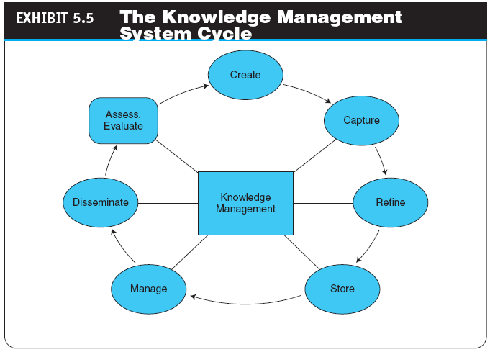
Copyright © 2012 Pearson Education, Inc. Publishing as Prentice Hall
5-<number>

Slide 18
Knowledge Management, Advisory Systems, and Electronic Commerce
KNOWLEDGE SHARING
  Software Tools for Knowledge Sharing
HOW IS KNOWLEDGE MANAGEMENT RELATED TO E-COMMERCE?
KM AND SOCIAL NETWORKS
  Knowledge creation
  Knowledge sharing
DEPLOYING KM TECHNOLOGIES
Copyright © 2012 Pearson Education, Inc. Publishing as Prentice Hall
5-<number>

Slide 19
Knowledge Management, Advisory Systems, and Electronic Commerce
ONLINE ADVICE AND CONSULTING
  Medical advice
  Management consulting
  Legal advice
  Gurus
  Financial advice
  Social networks
  Other advisory services
Copyright © 2012 Pearson Education, Inc. Publishing as Prentice Hall
5-<number>

Slide 20
Knowledge Management, Advisory Systems, and Electronic Commerce
automated question/answer (QA) system
A system that locates, extracts, and provides specific answers to user questions expressed in natural language
  Live Chat with Experts
Copyright © 2012 Pearson Education, Inc. Publishing as Prentice Hall
5-<number>

Slide 21
Knowledge Management, Advisory Systems, and Electronic Commerce
expert location systems (ELS)
Interactive computerized systems that help employees find and connect with colleagues who have expertise required for specific problems—whether they are across the country or across the room—in order to solve specific, critical business problems in seconds
  Seeking Expertise in Social Networks
Copyright © 2012 Pearson Education, Inc. Publishing as Prentice Hall
5-<number>

Slide 22
Collaborative Commerce
collaborative commerce (c-commerce)
The use of digital technologies that enable companies to collaboratively plan, design, develop, manage, and research products, services, and innovative EC applications
collaboration hub (c-hub)
The central point of control for an e-market; a single c-hub, representing one e-market owner, can host multiple collaboration spaces (c-spaces) in which trading partners use c-enablers to exchange data with the c-hub
Copyright © 2012 Pearson Education, Inc. Publishing as Prentice Hall
5-<number>

Slide 23
Collaborative Commerce
REPRESENTATIVE EXAMPLES OF COLLABORATIVE COMMERCE
  vendor-managed inventory (VMI)
  A system in which retailers make their suppliers fully responsible for determining when to order and possibly how much to order
  Retailer-Supplier Collaboration
    Example: Target
Copyright © 2012 Pearson Education, Inc. Publishing as Prentice Hall
5-<number>

Slide 24
Collaborative Commerce
  Reducing Transportation and Inventory Costs
  Reduction of Design Cycle Time
  Reduction of Product Development Time
  Elimination of Channel Conflict: Collaboration with Dealers and Retailers
Copyright © 2012 Pearson Education, Inc. Publishing as Prentice Hall
5-<number>

Slide 25
Managerial Issues
What are the e-government opportunities?
How do we design the most cost-efficient government e-procurement system?
How do we design the portfolio of e-learning knowledge sources?
How do we incorporate social networking–based learning and services in our organization?
What will the impact be of the e-book platform?
Copyright © 2012 Pearson Education, Inc. Publishing as Prentice Hall
5-<number>

Slide 26
Managerial Issues
How do we connect our expert location system and social networking initiatives?
How difficult is it to introduce e-collaboration?
Can we capitalize on C2C EC?
How much can be shared with business partners?
Who benefits from vendor-managed inventory?
Copyright © 2012 Pearson Education, Inc. Publishing as Prentice Hall
5-<number>

Slide 27
Summary
E-government activities
Implementing e-government to citizens, businesses, and its own operations
E-learning and training
E-books and their readers
Knowledge management and dissemination as an e-business
Copyright © 2012 Pearson Education, Inc. Publishing as Prentice Hall
5-<number>

Slide 28
Summary
Online advisory systems
C-commerce
Collaboration 2.0
C2C activities
Copyright © 2012 Pearson Education, Inc. Publishing as Prentice Hall
5-<number>

Slide 29

All rights reserved. No part of this publication may be reproduced, stored in a retrieval system, or transmitted, in any form or by any means, electronic, mechanical, photocopying, recording, or otherwise, without the prior written permission of the publisher. Printed in the United States of America.
Copyright © 2012 Pearson Education, Inc.
Publishing as Prentice Hall
Copyright © 2012 Pearson Education, Inc. Publishing as Prentice Hall
5-<number>

